Slide 1

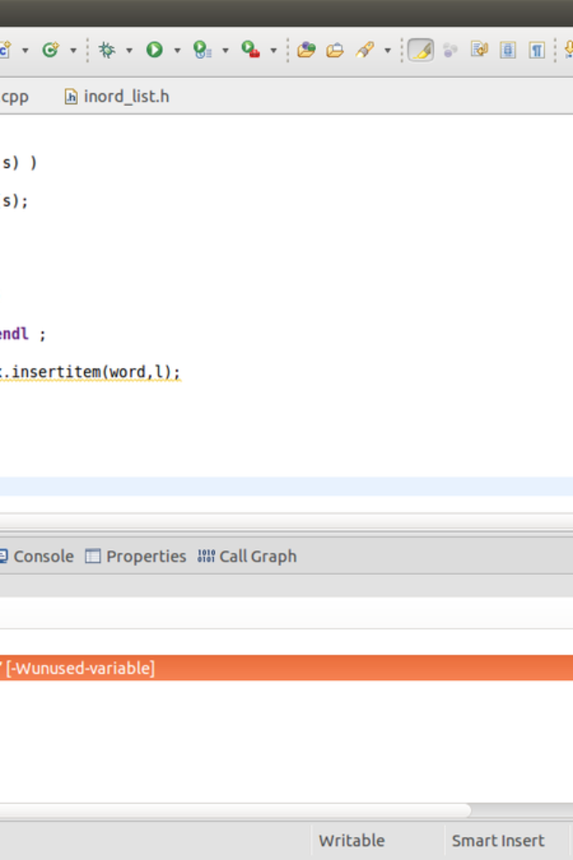
Introduction to Functions in C Language
In C language, a function is a group of statements that together perform a task. It provides modularity to a program and allows for reusability of code. Functions in C help in organizing big programs into smaller, manageable sections, making the code more readable and easier to maintain.

Slide 2
Purpose and Benefits of Using Functions
1
Modularity
2
Code Reusability
3
Abstraction
Functions allow breaking a program into small modules, making it easier to understand, debug, and maintain.
Functions can be used multiple times within a program, reducing redundancy and saving development time.
They provide an abstraction, as a programmer can use a function without knowing its internal details.

Slide 3
Syntax and Structure of a Function in C
Syntax
Structure
A function in C starts with the return type, followed by the function name and parameters enclosed in parentheses. The body of the function is enclosed in curly braces.
Return_Type function_name(Parameter_List) {
// Function body - code that performs the desired task
// Return statement (if the function has a return type)
return return_value;
}

Slide 4



Types of Functions in C
Built-in Functions
User-defined Functions
Library Functions
These functions are predefined in the compiler, such as printf(), scanf(), and sqrt().
Functions provided in C library, such as string manipulation functions like strlen(), strcmp(), etc.
Programmer-defined functions that are created to perform specific tasks and can be called within a program.

Slide 5
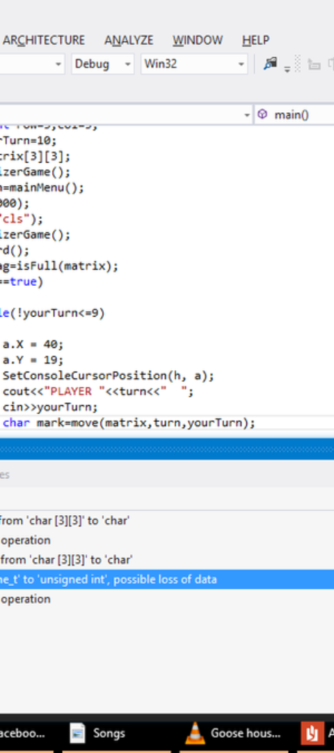
Parameters and Arguments in Functions
Parameters
Arguments
Inputs to a function that enable the function to perform its intended task.
Values passed to a function when the function is called, which correspond to the parameters.

Slide 6
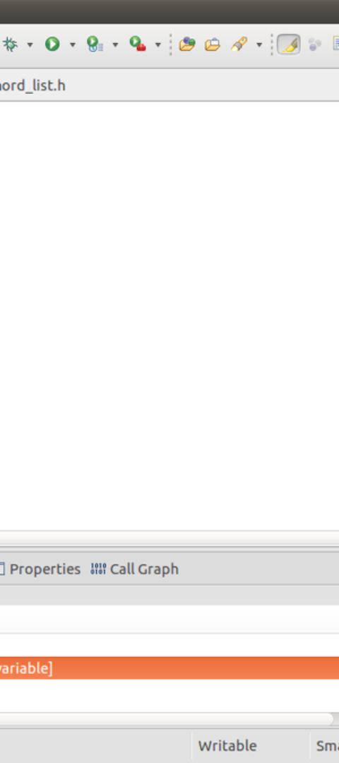
Return Types in Functions
1
Void
2
Integer
Used when a function does not return any value.
The most common return type, used to return integer values from a function.
3
Character
Used to return character values from a function.

Slide 7
Examples of Functions in C
1
Math Functions
Includes functions for mathematical operations like addition, subtraction, multiplication, and division.
2
String Functions
Functions for string manipulation such as concatenation, comparison, and length calculation.
3
Sorting Functions
Functions used for sorting arrays and lists, such as bubble sort, quicksort, and merge sort.

Slide 8
Fundamentals of Functions in C
1
Scoping
2
Recursion
3
Error Handling
Functions have their own scope and can have local variables that are only accessible from within the function.
C language supports recursive functions, allowing a function to call itself either directly or indirectly.
Functions play a vital role in error handling by returning error codes or using exception handling mechanisms.

Slide 9
Best Practices for Writing Functions in C
Naming Conventions
Documentation
Error Handling
Follow standard naming conventions to make functions easily recognizable and maintainable.
Provide clear and concise documentation for each function, explaining its purpose, inputs, and outputs.
Implement robust error handling mechanisms within functions to enhance the reliability of the code.

Slide 10
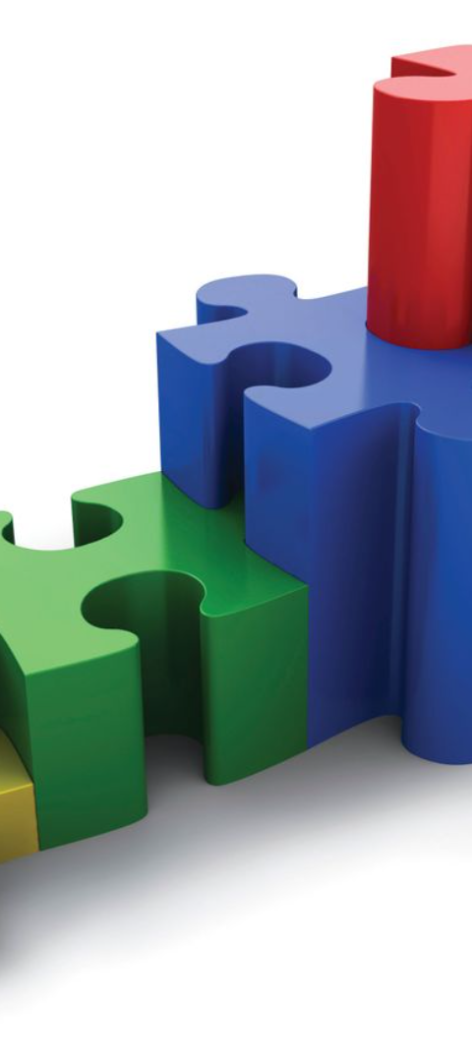
Concluding Remarks on C Functions
Functions are a fundamental concept in C programming, providing a way to structure and organize code for efficiency and reusability. Understanding the different types of functions, their syntax, and usage is crucial for any programmer working with the C language.

